Slide 1
Capstone 3
Market Basket Analysis
Customer Ecommerce Purchases
Jide Okesanjo

Slide 2
What’s the Problem?
Why is it important?
Increases Customer Satisfaction
Take a more Human-centered approach towards consumer shopping experience online.
Help optimize consumer choices when shopping online and in store.

Slide 3
Data Origins
Where is the data from?
UCI Machine Learning Repository
The data was donated in 2015 by an anonymous online retail store in the UK. It contains observational transactional data of purchases between 2010 and 2011.
The data originally contained over 500,000 rows and 8 columns.

Slide 4
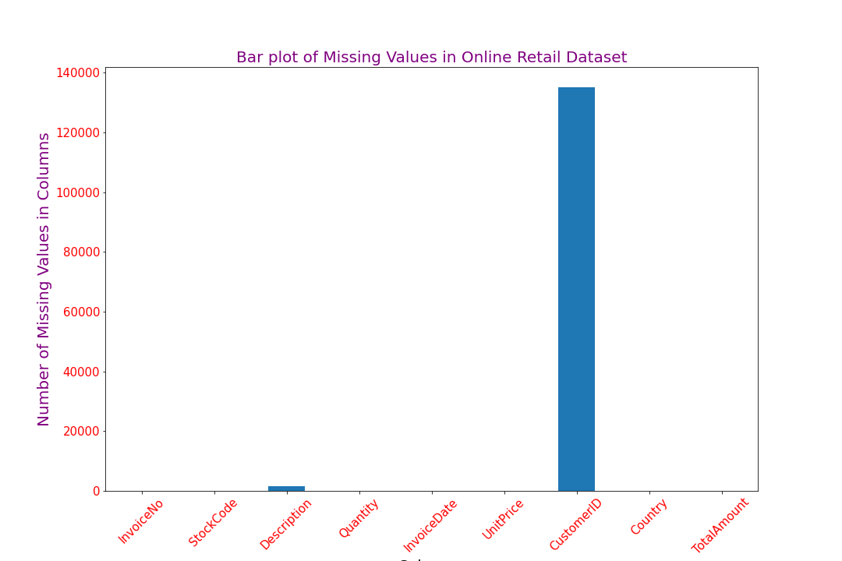
Missing Data
One in every four transactions was missing CustomerID
Item Descriptions for less than one percent of the data was also missing.
Missing Items were either returned or canceled or both.

Slide 5
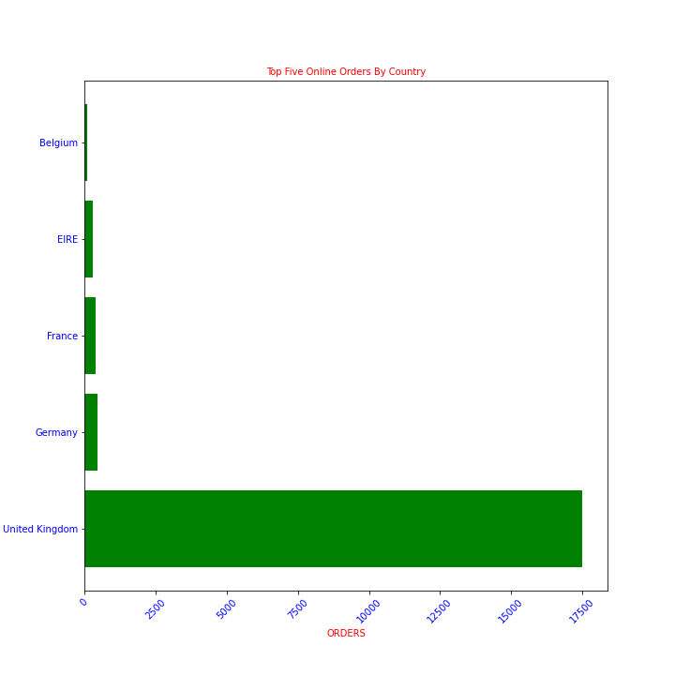
Who are the most popular customers?
Germany and France come in second and third place for most orders placed
United Kingdom, France, and Germany also had the most customers.
Most popular item ordered was White Hanging T-Light Holder

Slide 6
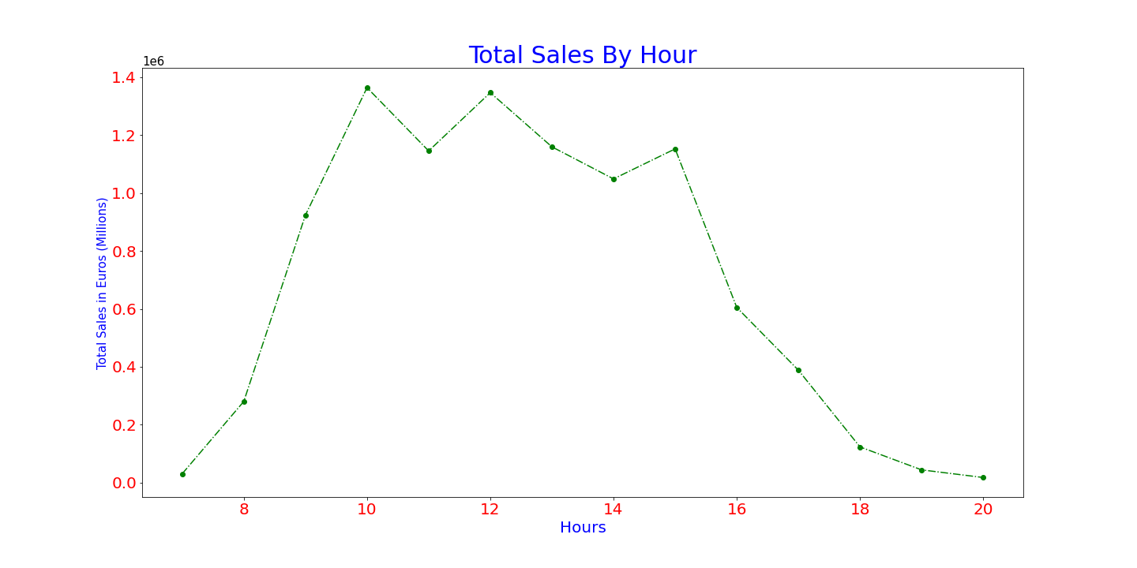
When do people purchase items?
The store accumulated the most sales between 10am and 3pm, with sharp decline in sales in the later hours of the evening
October through December marks the busiest months of the year.

Slide 7
Modelling and Preprocessing
Apriori algorithm was used to find connections between different items in the dataset.
This algorithm assumes that any subset of a customer’s frequent itemset must be frequent
The Algorithm unpacks customer purchases into support, lift and confidence.
Lift scores higher than 1 indicate stronger association between items; Customers who item A are more likely to buy item B
Notes:
Assuming we had 100 customers; 5 of bought candle sticks while 8 bought picture frames and 10 bought both, support would be 10/100 = 0.1;
confidence would be 0.1/.05 = 2; lift would be 2/0.08 = 25

Slide 8
Results
White Hanging heart t-light holder had the highest support
Despite this, Regency Tea plates had higher lift.
People that bought the white hanging heart t-light holder were more likely to buy the regency cake stand 3 tier, but this relationship was relatively weak

Slide 9
Recommendations
Place items that come in different colors close to one another
If store makes its own merchandise, it would be wise to consider manufacturing items in different colours

